Slide 1



UNIVERSITY
ANALYSIS

Slide 2

CONTENT
01
OVERVIEW
02
GOAL
03
ER DIAGRAM
04
POWER BI PROBLEM STATEMENT
05
EDA PROBLEM STATEMENT
06
CONCLUSION

Slide 3



OVERVIEW
The database contains a wealth of information about universities in several countries and has been carefully evaluated using three different rating systems. In addition, it contains in-depth information about the countries where these prestigious universities are located, including their campuses, specific rankings and complex evaluation criteria.

Slide 4





GOALS AND OBJECTIVES
Objective n° 1
Objective n° 2
Objective n° 3
Enhance Data-Driven Decision-Making
Evaluate and Improve Academic Rankings
Promote Diversity and Inclusivity

Slide 5
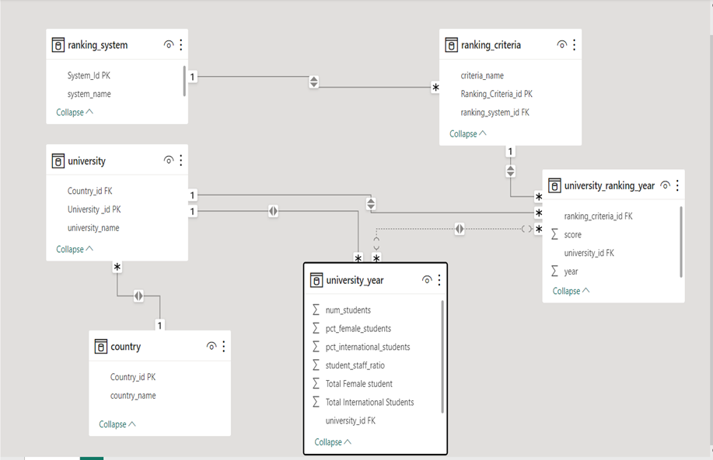
ER Diagram

Slide 6

POWER BI PROBLEM STATEMENT

Slide 7

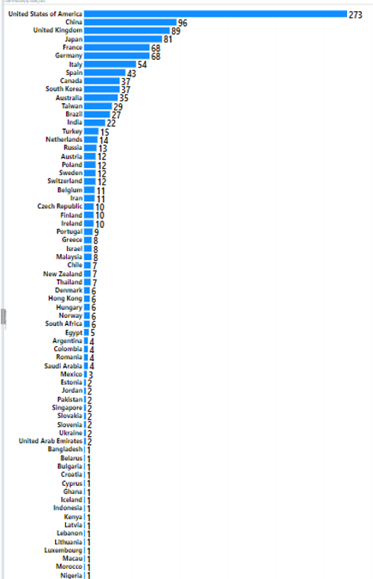
How many universities are there in each country?
Gleaning from chart USA have highest universities i.e. 273.
Countries such as China, Japan, and the United States, have a large number of universities, reflecting their significant investments in research and education.

Slide 8
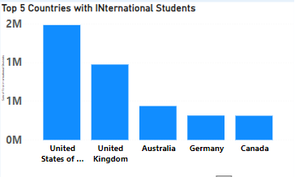
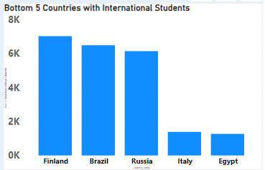
What is the distribution of international students across different countries?
The United States, the United Kingdom, Australia, and the Netherlands are favored destinations due to welcoming environments and diverse academic offerings.
In contrast, Finland, Russia, and Italy attract fewer international students, possibly due to limited programs or language barriers.

Slide 9
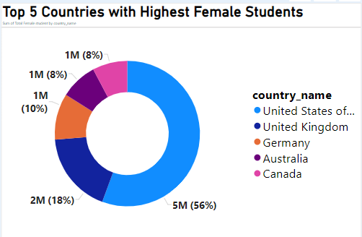
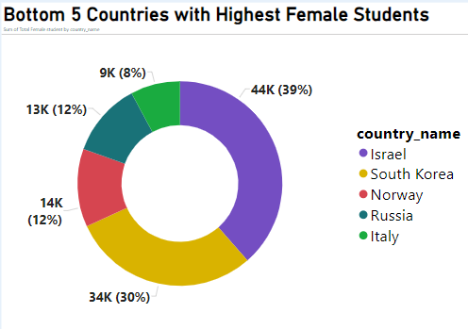
Which country has the highest number of female students enrolled in universities?
Top 5 Countries with highest Female Candidates
Leading nations like the United States, the United Kingdom, and the Netherlands promote gender equality and inclusive education.
B. Bottom 5 Countries with highest Female Candidates
Underperforming countries such as Egypt, Brazil, and Italy may face barriers to female education and gender inequality.

Slide 10
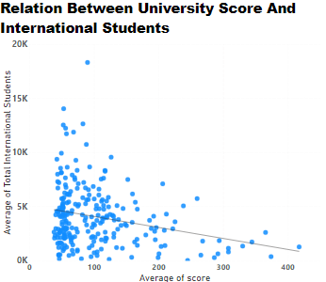
Is there a correlation between a university's score and the number of international students?
There is a negative correlation between the number of international students and university scores, indicating that as academic standing rises, international student enrollment tends to decrease.

Slide 11
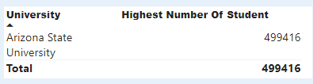
Which university has the highest number of students?
Arizona State University has the highest student enrollment among all universities, showcasing its ability to cater to diverse learning needs and foster a thriving academic community.

Slide 12
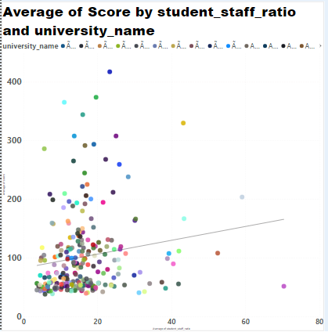
Is there a correlation between a university's ranking and its student-staff ratio?
Examining the data there is a positive correlation between university's student-to-staff ratio to its ranking provides insights into institutional performance metrics.

Slide 13
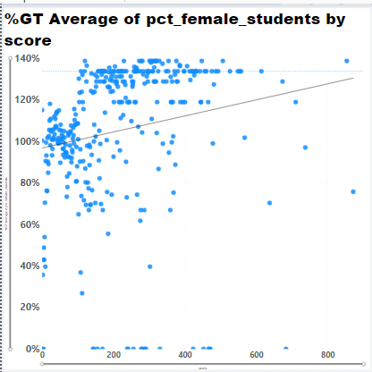
How does the percentage of female students impact a university's ranking?
Power BI's analysis reveals a positive correlation between university rankings and the proportion of female students, indicating that higher-ranking universities tend to have more female students.

Slide 14
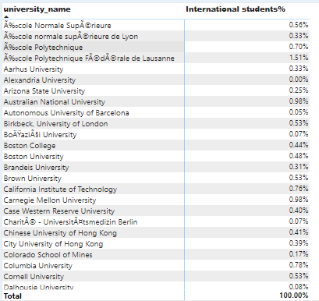
How does the percentage of international students vary across different universities?
From the table it’s a clear glimpses of international students percentage varying across different universities.

Slide 15
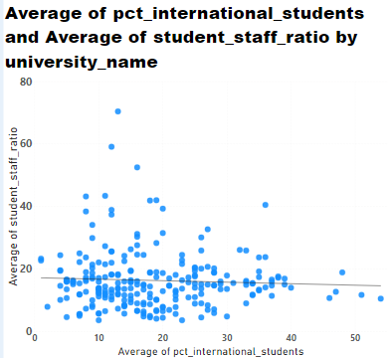
What is the impact of a university's ranking on the number of international students it attracts?
Ã‰cole Polytechnique FÃ©dÃ©rale de Lausanne has the highest average of international students (54.00), and the University of Bonn has the highest average student-to-staff ratio (70.40).
The relationship between a university's ranking and international student enrollment is influenced by various variables, making it a complex interplay of factors.

Slide 16
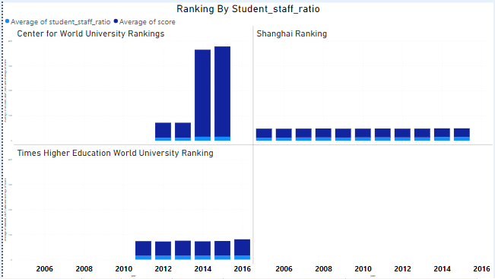
How does the ranking system affect a university's student-staff ratio?
Gleaning from charts university’s student staff ratio clearly affected by Center For World University Rankings.
A little affected by Times Higher Education World University Ranking and not affected by Shanghai Ranking

Slide 17
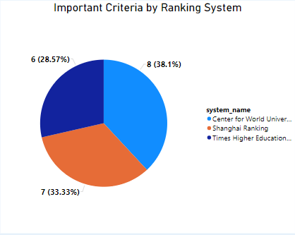
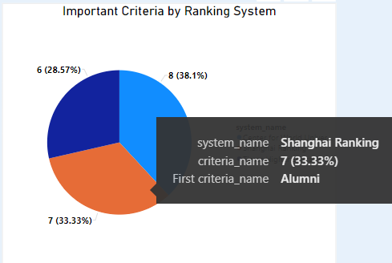
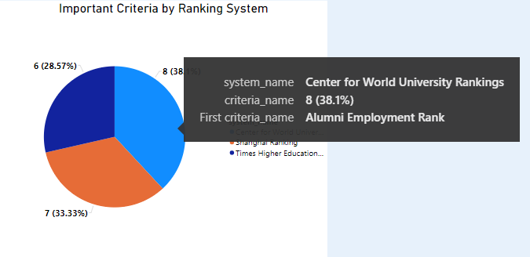
What are the most important criteria
considered by ranking systems?
Gleaning from above chart Alumni Employment Rank is the most important criteria considered by CWUR while Alumni is most taken by Shanghai Ranking.

Slide 18
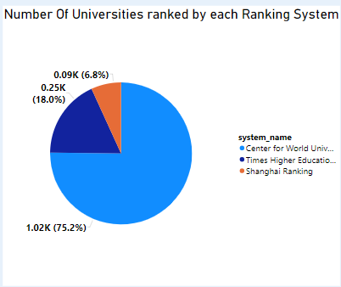
How many universities are ranked by each ranking system?
Insights from the pie chart -
75.2 % of Universities are ranked by CWUR.
18% of Universities are ranked by Times Higher Education World University Ranking
6.8% of Universities are ranked by Shanghai Ranking.

Slide 19
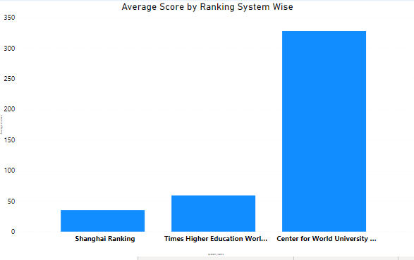
What is the average score for universities according to each ranking system?
Gleaning from the chart CWUR has the highest average score followed by Times Higher Education University Ranking and Shanghai Ranking.

Slide 20
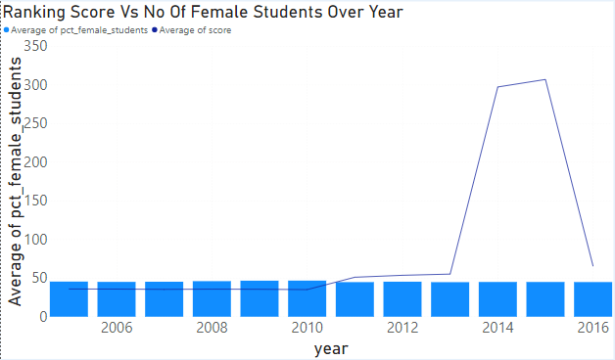
Is there a relationship between a university's ranking score and the percentage of female students enrolled?
An analysis shows a positive correlation between a university's ranking score and the percentage of female students enrolled, indicating that universities with more female students tend to achieve higher rankings.

Slide 21
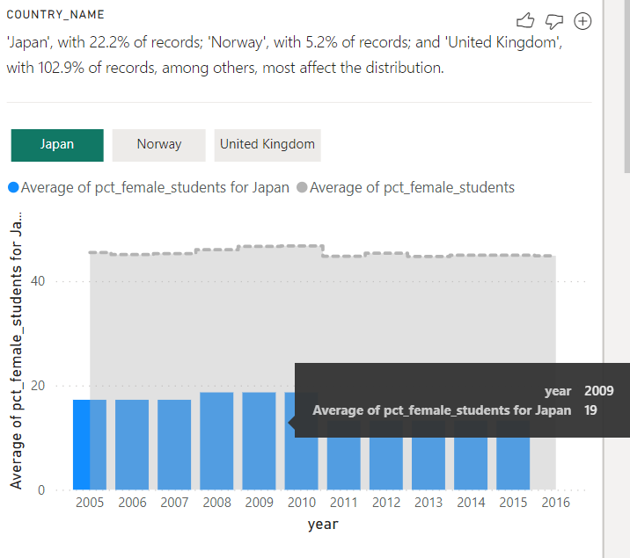
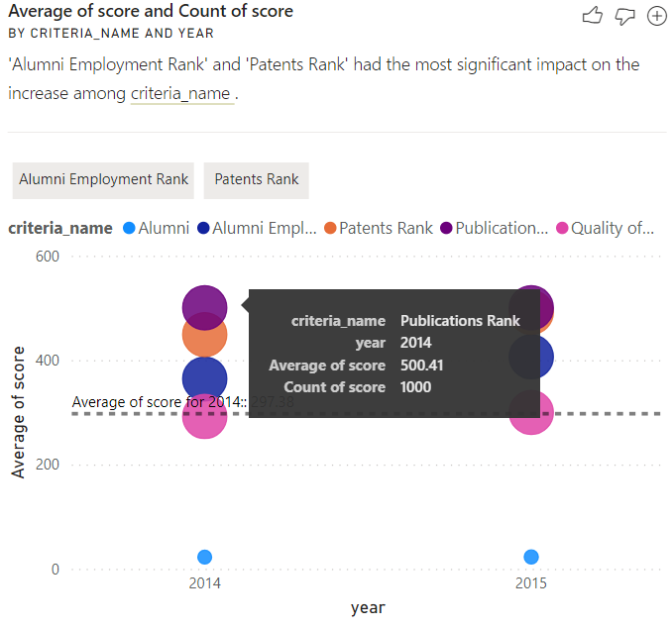
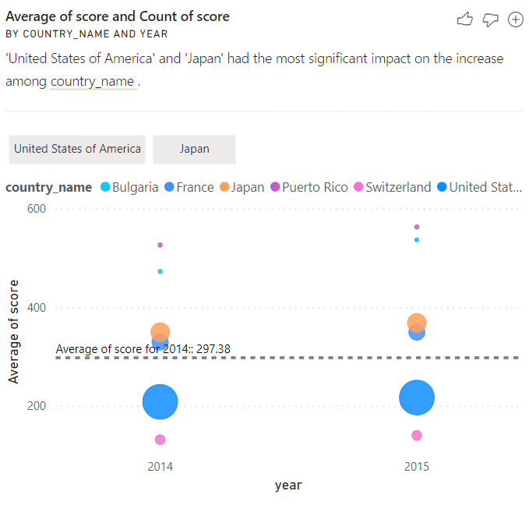
Insights

Slide 22
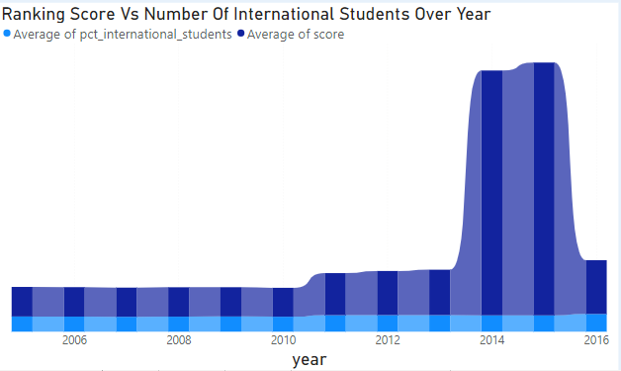
How does the ranking of percentage of international students vary across different years?
There is immense increase of International Students from 2013 to 2015

Slide 23
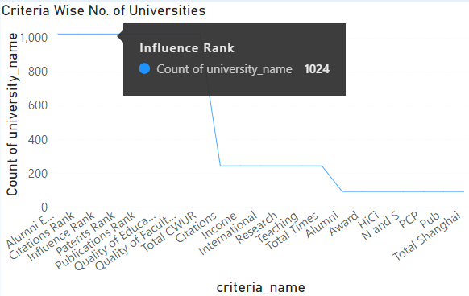
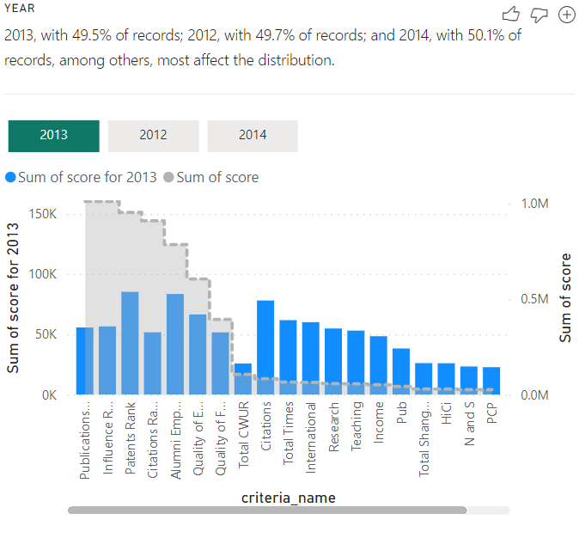
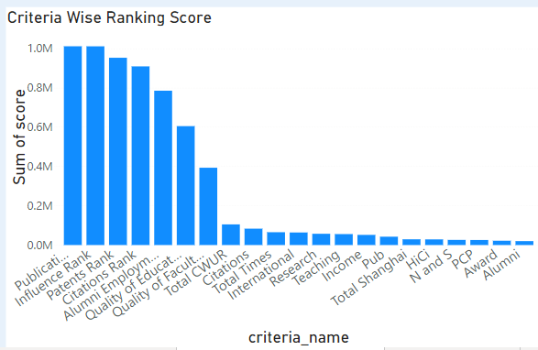
Are there any significant trends or patterns in the number of universities from different criteria's?
Following is the summary gleaned from line chart.
﻿The top 8 criteria_name all had Count of university_name of 1,024.﻿﻿ ﻿﻿ ﻿﻿Across all 21 criteria_name, Count of university_name ranged from 93 to 1,024.﻿﻿
This is the analyze done from
The beside column chart that
how there is distribution
amongst criteria’s.

Slide 24
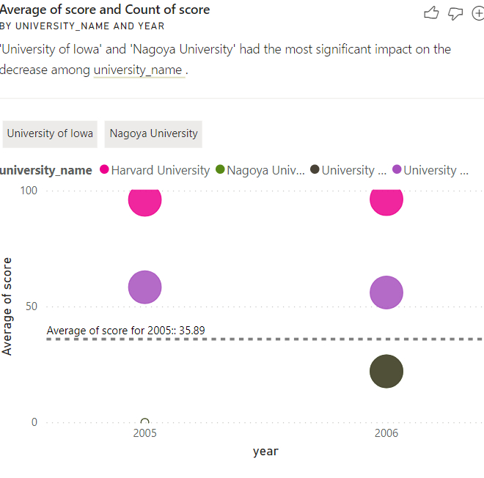
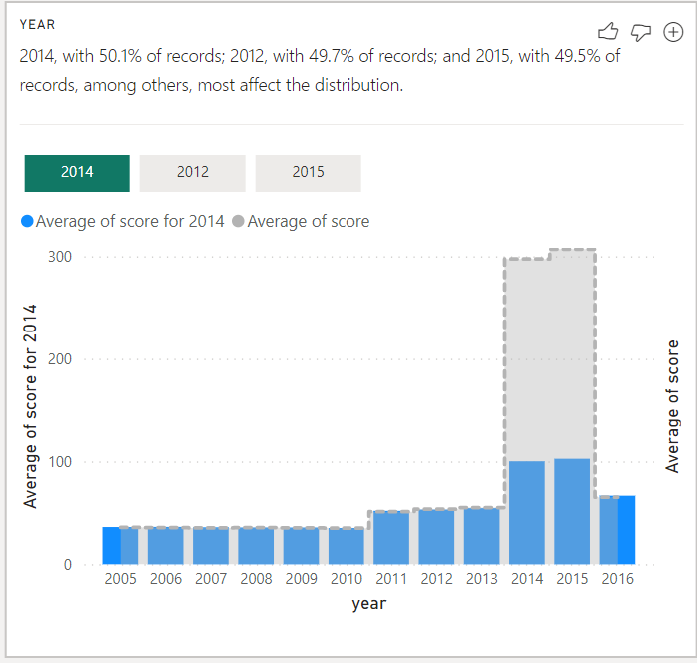
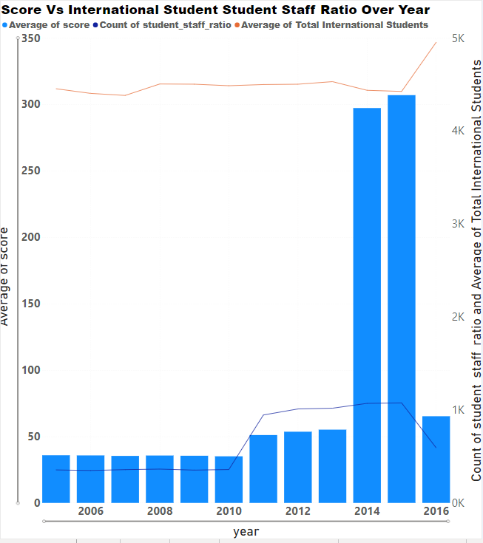
How does the percentage of international students affect a university's student-staff ratio?
The analysis is done based on the charts provided with different prospect.

Slide 25
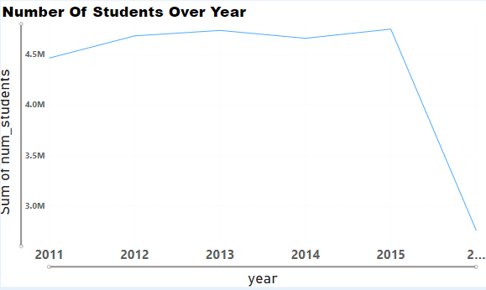
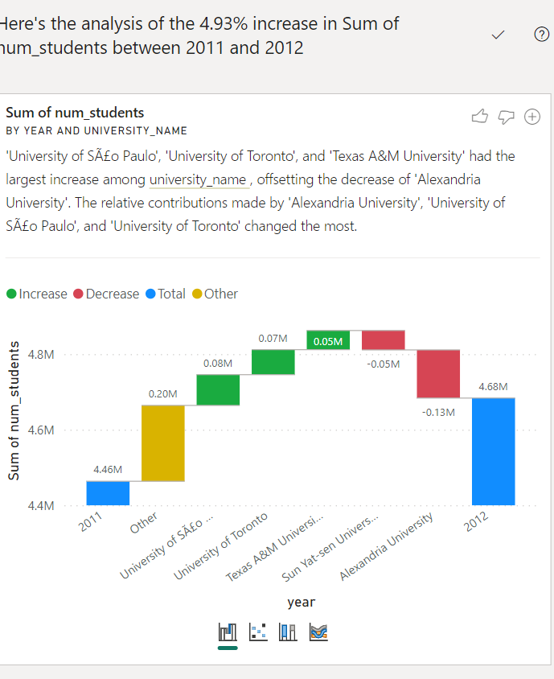
How does the number of students in universities change over time?
At 4751004, 2015 had the highest Sum of num_students and was 72.50% higher
than 2016, which had the lowest Sum of num_students at 2754163. 2015
accounted for 18.24% of Sum of num_students. Across all 6 year, sum of
num_students ranged from 2754163 to 4751004.
After deep diving into the certain increase between 2011 and 2012, it came into notice that there is 4.93% increase in Sum of students between 2011 and 2012

Slide 26
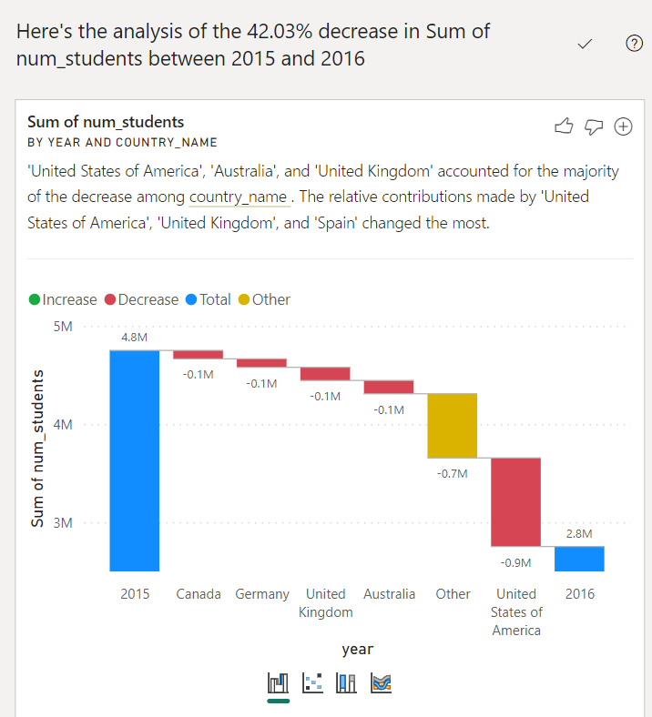
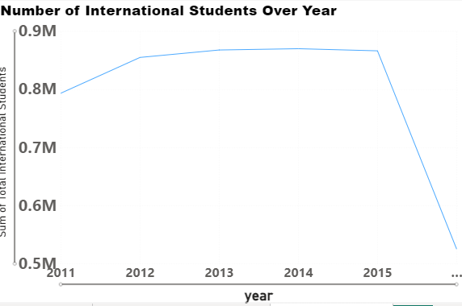
Gleaning from above waterfall chart there is 42.03% of decrease in sum of students from 2015 to 2016. United States of America , Australia and United Kingdom accounted major decrease.
At 870001, 2014 had the highest Sum of Total International Students and was 65.76% higher than 2016, which had the lowest Sum of Total International Students at 524869.﻿﻿ ﻿﻿ ﻿﻿ ﻿﻿2014 accounted for 18.21% of Sum of Total International Students.﻿﻿ ﻿﻿ ﻿﻿Across all 6 year, Sum of Total International Students ranged from 524869 to 870001.﻿﻿

Slide 27
Problem Statement In EDA

Slide 28
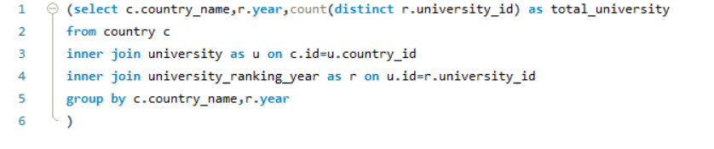
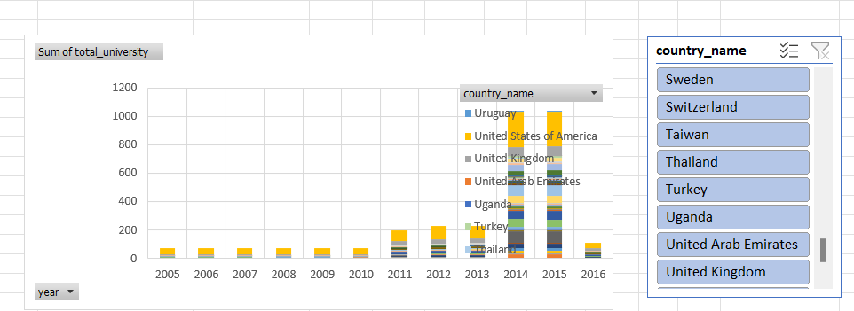
How has the number of universities changed over the years in each country?
The solution has been achieved with the help of SQL workbench for calculation, data extraction and Excel for data visualization using pivot table and chart.
For better visualization slicers had been added for country.

Slide 29
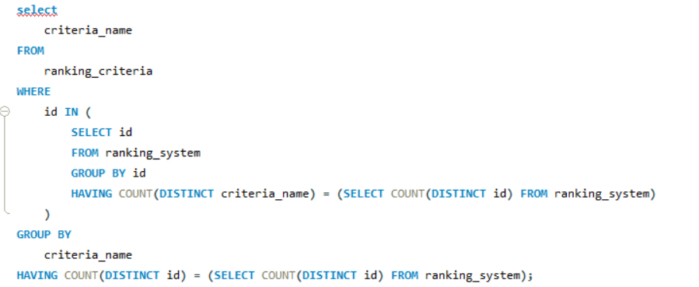

Are there any common criteria used by different ranking systems?
Gleaning from the database no common criteria used by university ranking systems, each has its unique focus and priorities.
This diversity underscores the importance of selecting a ranking system that aligns with an institution’s goals and missions.

Slide 30
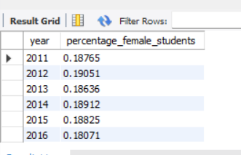
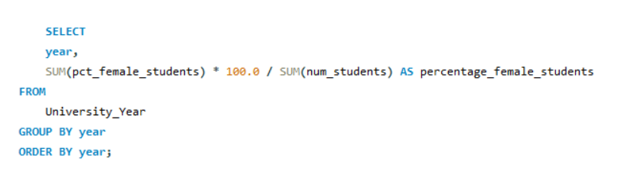
What is the trend in the percentage of female students over time?
Gleaning from chart there is some trend we can see percentage of female students over time.

Slide 31
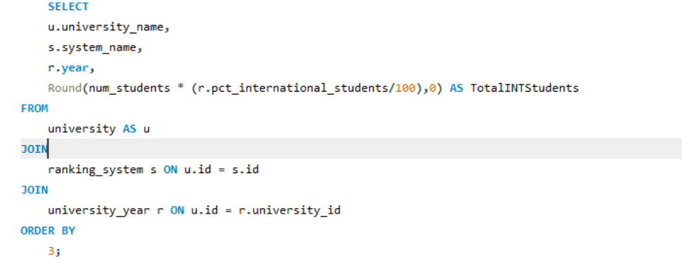
How does the choice of ranking system affect a university's international student enrolment?
Gleaning from line chart we can see the visibility of university’s international student enrolment among ranking system.

Slide 32
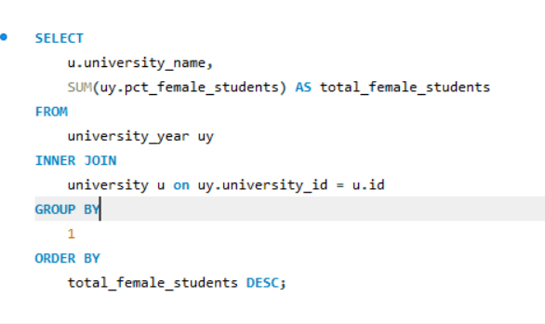
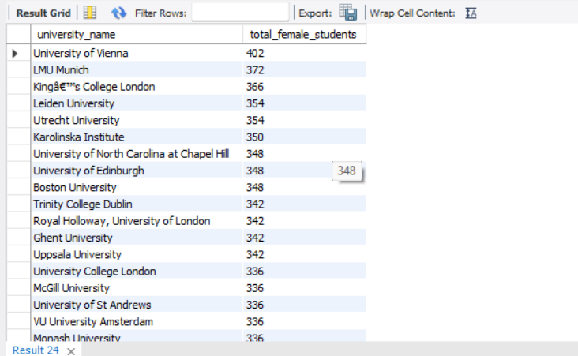
How does the number of female students differ among universities?
As we can see University Of Vienna have maximum number of female students.

Slide 33
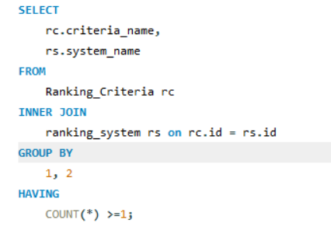

Are there any criteria that have different weights in different ranking systems?
Gleaning from the chart Times Higher Education World University Ranking opts Teaching Criteria, Shanghai Ranking opts International and Center for World University Ranking goes with Research Criteria.

Slide 34
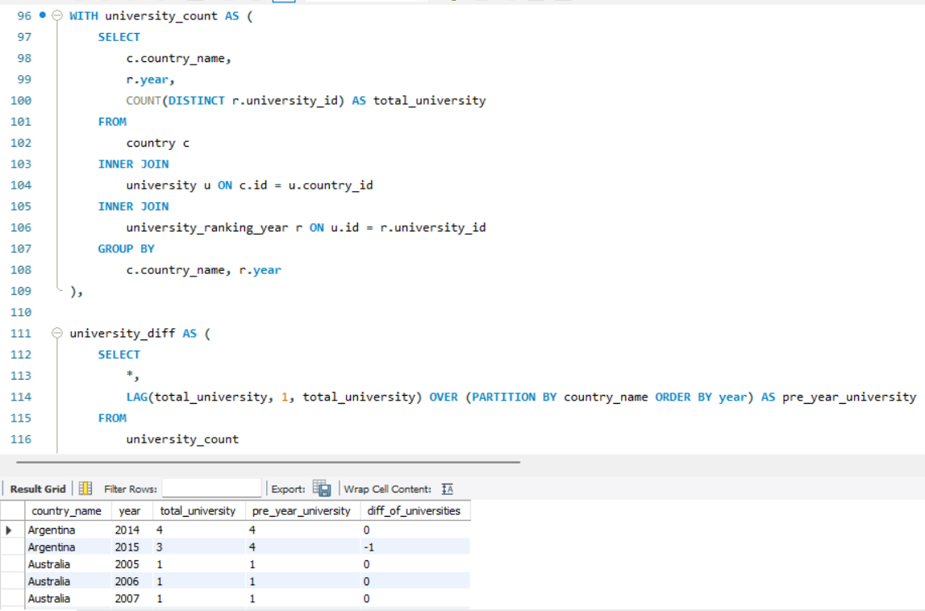
How has the ranking of universities changed over the years?
In the above chart there is variation among university over the years. United States Of America having the highest variation.

Slide 35
Is there a relationship between a university's score and the student-staff ratio
Gleaning from chart there is positive relationship between university’s score and student staff ratio.

Slide 36
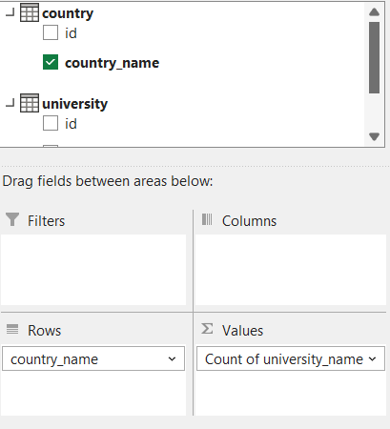
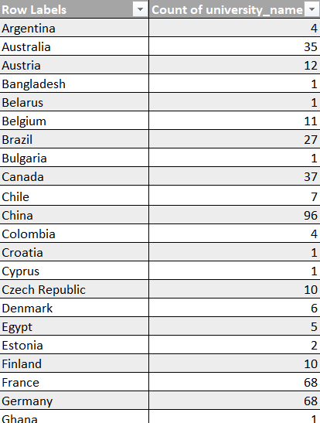
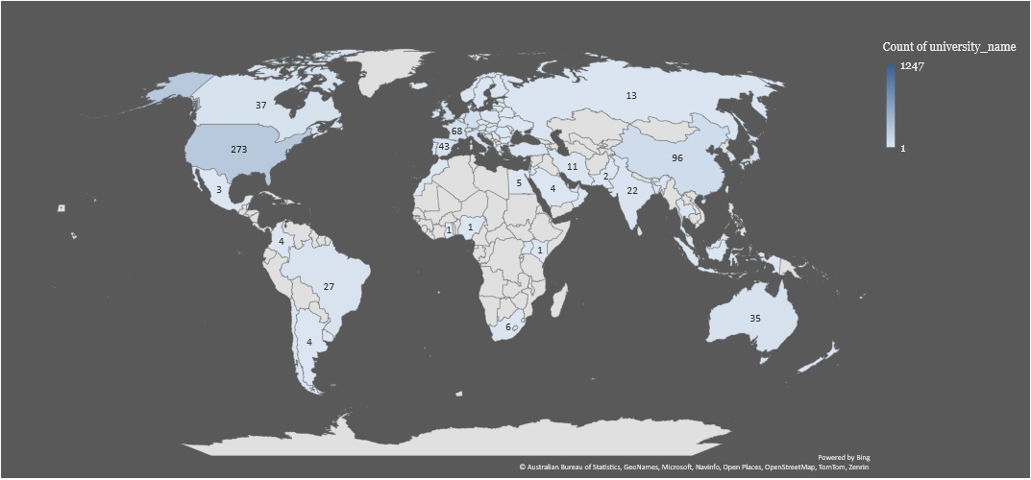
What is the distribution of universities across different countries?
In the map there is clearly data shown of how universities have been distributed across different countries.

Slide 37
Conclusion :
Understanding the dynamics of university rankings across diverse systems is a multifaceted endeavor, unveiling intriguing insights into global education landscapes.
Criteria Influence: Examining various ranking systems revealed the impact of criteria like Citations and Quality of Education on university positions. However, their significance varied significantly across different systems.
System Variations: Discrepancies among ranking systems highlighted the diversity in assessment methodologies. While some universities consistently performed well, differences in evaluation criteria led to varied rankings.
Temporal Trends: Analysis over time showcased fluctuations in university metrics, emphasizing the evolving nature of academic institutions.
Insights & Recommendations:
No universal formula exists for rankings due to differing methodologies.
Universities should focus on enhancing various criteria for improved standings.
Transparency in methodologies aids better interpretation of results.
The analysis illuminates the complex relationship between criteria, methodologies, and temporal shifts, emphasizing the need for a nuanced approach to understanding and utilizing university rankings effectively.

Slide 38




STRATEGIES
RANKING SYSTEM EVALUATION
DIVERSITY AND INCLUSIVITY PROMOTION
DATA DRIVEN DECISION MAKING
STRATEGY N°1
STRATEGY N°2
STRATEGY N°3

Slide 39

THANK'S FOR WATCHING

